Slide 1
CORD COLOR:
OCTOBER ----DECEMBER
ORANGE

Slide 2

Hetzel Tile & Marble Employee/Significant Other
Christmas Party
Thursday, December 6th
3:30-5:30
Trysting Place Pub
N71 W12980 Appleton Avenue
Menomonee Falls
Food, Beverages, Festivities & Gifts!!
SEE ALL OF YOU THERE!!

Slide 3


January-March
Cord Color
WHITE

Slide 4


CORD COLOR OCTOBER-DECEMBER
ORANGE

Slide 5

July –September
CORD COLOR-RED

Slide 6


Hetzel Tile & Marble
Employee Christmas Party
Thursday, December 7th
3-5 P.M.
Trysting Place Pub
N71 W12980 Appleton Avenue
Menomonee Falls
Join us for Food, Beverages & Presents!
Prizes for the BEST ugly Christmas Sweater!!

Slide 7


HETZEL TILE TOOLS
Do not remove any tools, cutting machines, setting materials, etc. from this warehouse without approval from Russ, Jason or John.
Each tool is numbered and inventoried. It must be checked out.
There are no exceptions.
Thank you,
Hetzel Tile & Marble

Slide 8

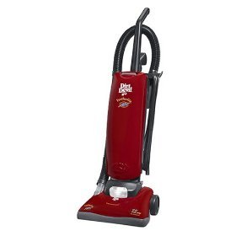
Do Not Remove Vacuum from HTM Office. This is not a JOB SITE Tool.

Slide 9
JULY –SEPTEMBER
CORD COLOR
RED

Slide 10
DON’T FORGET: CORD COLOR APRIL-JUNE
GREEN

Slide 12
CORD COLOR-JANUARY-MARCH
WHITE

Slide 13



CORD COLOR:
APRIL-JUNE
GREEN

